Slide 1
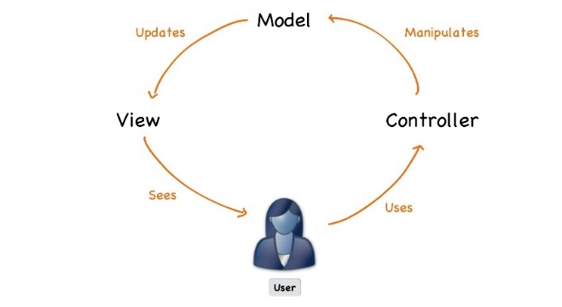



C# Web Basics
Course Introduction
SoftUni Team
Technical Trainers
Software University
https://softuni.bg

Slide 2
Table of Contents
Course Objectives
Training and Team
Course Organization
Course Infrastructure
Evaluation Criteria

Slide 3
Have a Question?
sli.do
#csharp-web

Slide 4

Course Objectives

Slide 5
C# Web Basics
Web Fundamentals
HTTP Protocol
Custom Web Server
Custom MVC Framework
Custom View Engine

Slide 6
ASP.NET Core
Essentials of ASP.NET Core
Razor View Engine
Security and Identity
Project Architecture
Unit Testing
Control Flow
Deployment and Continuous Integration

Slide 7
Practical Programming Exam
1 practical problem for 4 hours
Implementing a simple web application with:
Custom MVC Framework
Custom Web Server
Part of the of Views
Solutions are evaluated by hand after the exam

Slide 8
Theoretical Exam
You will have 30 minutes once you enter
Multiple-choice with 1 or more correct answers
English
Automated quiz system
Available the day of the practical exam
Before the Practical Exam
You can submit your answers just one time

Slide 9

The Team

Slide 10
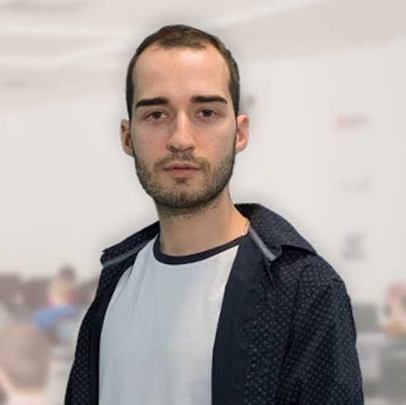
Module Team (Trainers)
Nikolay Kostov
Solutions Architect @ ZenCodeo
15+ years in the IT
Developer, Manager, Trainer, Architect
Аctive role in the development of the Judge platform - https://judge.softuni.bg/
Microsoft Certified Trainer
Personal blog: nikolay.it

Slide 11

Course Organization

Slide 12
C# Web Module at SoftUni – Timeline
14-January-2020
16-February-2020
C# Web Basics
5 weeks * 2 times / week
12 credits
Start: 14-January-2020
Exam: 16-February-2020
Re-Take Exam: 28-April-2020
ASP.NET Core
7 weeks * 2 times / week
18 credits
Start: 18-February-2020
Project Defense: 25-April-2020
Re-Take Exam: 30-April-2020

Slide 13

Course Workflow
Live coding
You no longer have homework
Fix bugs and implement features in the custom MVC framework
Work with git and github
Groups of lectures are followed by workshops
Knowledge is used to extend an application
Best practices are applied

Slide 14



Scoring System for the Course
Theoretical Exam 5%
Presence in class 5%
PracticalExam 95%
Evaluation

Slide 15



Course Web Site, Forum and FB Group
Official web site:
Official discussion forum:
Official Facebook groups:
https://softuni.bg/trainings/2355/csharp-web-basics-may-2019
https://softuni.bg/forum/categories/66/csharp-web-development-basics
https://www.facebook.com/groups/CSharpWebMay2019/

Slide 16
Course Web Site, Forum and FB Group
Official web site:
Official discussion forum:
Official Facebook group:
Community Facebook group:
https://softuni.bg/modules/47
https://softuni.bg/forum/categories/65
https://www.facebook.com/groups/CSharpWeb
https://www.facebook.com/SoftUniCSharpCommunity/

Slide 17
Questions?
Notes:
17

Slide 18












SoftUni Diamond Partners

Slide 19




SoftUni Organizational Partners

Slide 20
Trainings @ Software University (SoftUni)
Software University – High-Quality Education, Profession and Job for Software Developers
softuni.bg, softuni.org
Software University Foundation
softuni.foundation
Software University @ Facebook
facebook.com/SoftwareUniversity
Software University Forums
forum.softuni.bg
Notes:
20

Slide 21

License
This course (slides, examples, demos, exercises, homework, documents, videos and other assets) is copyrighted content
Unauthorized copy, reproduction or use is illegal
© SoftUni – https://softuni.org
© Software University – https://softuni.bg
Notes:
21

